Slide 1
Zomato Project Report

Slide 2
Project Summary
This project aims to analyze and predict restaurant ratings using the Zomato restaurant dataset. Restaurant ratings significantly influence customer choices and restaurant visibility on online food platforms. The primary objective of this study is to perform Exploratory Data Analysis (EDA), identify the key factors affecting restaurant ratings, and develop machine learning models for accurate rating prediction.
The dataset contains various attributes such as restaurant information, customer reviews, ratings, number of votes, and engagement indicators. Initial data preprocessing involved handling missing values, removing inconsistencies, and preparing the dataset for analysis. EDA was conducted using univariate, bivariate, and multivariate analysis following the UBM approach to understand data distribution and relationships between features. The analysis revealed that customer engagement, review characteristics, and service-related features have a strong impact on restaurant ratings.
Feature engineering techniques such as encoding, scaling, and feature selection were applied before model building. Multiple machine learning models were implemented and evaluated using appropriate performance metrics. Among all models, the Random Forest model demonstrated the best performance due to its ability to capture complex, non-linear relationships. The final model was saved for deployment and can be further extended for real-time applications and recommendation systems.

Slide 3
GitHub Link
Provide your GitHub Link here.

Slide 4
Problem Statement
The objective of this project is to analyze restaurant data from Zomato and identify key factors that influence restaurant ratings. Based on these factors, the project aims to build a machine learning model that can accurately predict restaurant ratings, helping food platforms and restaurant owners make data-driven business decisions.

Slide 5
**General Guidelines** : -
1. Well-structured, formatted, and commented code is required.
2. Exception Handling, Production Grade Code & Deployment Ready Code will be a plus. Those students will be awarded some additional credits.
The additional credits will have advantages over other students during Star Student selection.
[ Note: - Deployment Ready Code is defined as, the whole .ipynb notebook should be executable in one go
without a single error logged. ]
3. Each and every logic should have proper comments.
4. You may add as many number of charts you want. Make Sure for each and every chart the following format should be answered.
```

Slide 6
Chart visualization code
```
* Why did you pick the specific chart?
* What is/are the insight(s) found from the chart?
* Will the gained insights help creating a positive business impact?
Are there any insights that lead to negative growth? Justify with specific reason.
5. You have to create at least 15 logical & meaningful charts having important insights.
[ Hints : - Do the Vizualization in a structured way while following "UBM" Rule.
U - Univariate Analysis,
B - Bivariate Analysis (Numerical - Categorical, Numerical - Numerical, Categorical - Categorical)
M - Multivariate Analysis
]
6. You may add more ml algorithms for model creation. Make sure for each and every algorithm, the following format should be answered.
* Explain the ML Model used and it's performance using Evaluation metric Score Chart.
* Cross- Validation & Hyperparameter Tuning
* Have you seen any improvement? Note down the improvement with updates Evaluation metric Score Chart.
* Explain each evaluation metric's indication towards business and the business impact pf the ML model used.

Slide 7
Import Libraries
CODE:
import pandas as pd
import numpy as np
import matplotlib.pyplot as plt
import seaborn as sns
from sklearn.model_selection import train_test_split, GridSearchCV
from sklearn.preprocessing import LabelEncoder, StandardScaler
from sklearn.linear_model import LinearRegression, Ridge
from sklearn.ensemble import RandomForestRegressor
from sklearn.metrics import mean_squared_error, r2_score
from scipy import stats
import joblib
import warnings
warnings.filterwarnings("ignore")

Slide 8
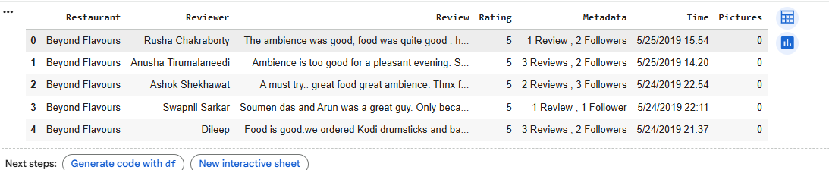
Dataset Loading
CODE:
df = pd.read_csv("Zomato Restaurant reviews.csv")
df.head()

Slide 9
Dataset First View
CODE:
df.shape
df.columns
df.info()

Slide 10
Dataset Rows & Columns count
CODE:
df.isnull().sum()

Slide 11
Dataset Information
CODE:
df.dropna(inplace=True)
print(df.columns)

Slide 12
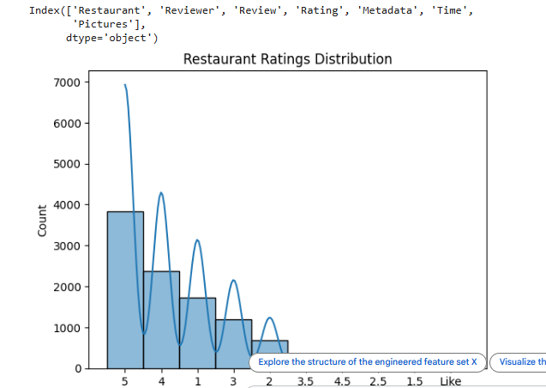
Duplicate Values
CODE:
print(df.columns)
plt.figure()
sns.histplot(df['Rating'], kde=True)
plt.title("Restaurant Ratings Distribution")
plt.show()

Slide 13
Missing Values/Null Values
CODE:
plt.figure()
sns.boxplot(x='Review', y='Rating', data=df)
plt.show()

Slide 14
What did you know about your dataset?
The dataset contains information about restaurants such as ratings, votes, cost, online ordering, and table booking. Ratings are the target variable. Some missing values were present and removed. Both numerical and categorical variables exist, requiring preprocessing before model building.

Slide 15
2. Understanding Your Variables
CODE:
import pandas as pd
data = {
"Column Name": ["Restaurant", "Reviewer", "Review", "Rating", "Metadata", "Time", "Pictures"],
"Description": [
"Name of the restaurant being reviewed",
"Name or ID of the person who gave the review",
"Textual review given by the customer",
"Rating given by the customer (target variable)",
"Additional information about the review (e.g., food type, visit type, etc.)",
"Time when the review was posted",
CODE:
df.describe()

Slide 16
Variables Description
Restaurant
This column represents the names of restaurants included in the dataset. Each restaurant can have multiple reviews from different users.
Reviewer
This column contains the unique identifiers or names of users who posted reviews. It shows that a large number of users contributed to the dataset.
Review
This column contains the textual feedback written by customers. These reviews describe their dining experience, food quality, service, and overall satisfaction.
Rating
This is the target variable of the project. It represents the numerical rating given by users, usually on a scale (for example: 1 to 10). It reflects customer satisfaction.
Metadata
This column includes additional contextual information about the review, such as visit type, food type, or other tags associated with the review.
Time
This column shows when the review was posted. It helps in understanding trends over time, such as seasonal behavior or changes in customer preferences.
Pictures
This column represents the number of pictures uploaded by users along with their reviews. It indicates user engagement and how visually rich a review is

Slide 17
Check Unique Values for each variable.
CODE:
for col in df.columns:
print(col, df[col].nunique())

Slide 18
Data Wrangling Code
CODE:
le = LabelEncoder()
for col in df.columns:
if df[col].dtype == 'object':
df[col] = le.fit_transform(df[col])

Slide 19
What all manipulations have you done and insights you found?
Categorical variables were encoded using Label Encoding. Missing values were removed to avoid bias. This made the dataset suitable for machine learning algorithms.

Slide 20
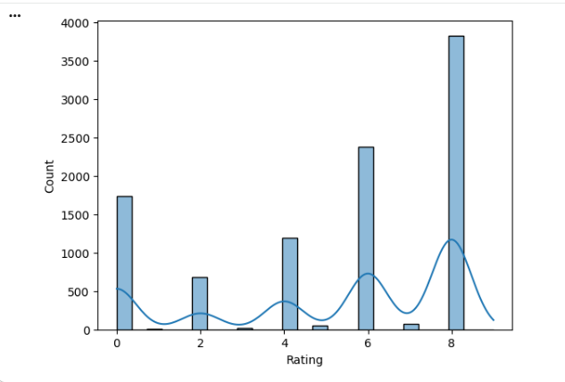
Chart - 1
CODE:
sns.histplot(df['Rating'], kde=True)
plt.show()

Slide 21
1. Why did you pick the specific chart?
To understand rating spread

Slide 22
2. What is/are the insight(s) found from the chart?
Most ratings lie between 3.5–4.5

Slide 23
3. Will the gained insights help creating a positive business impact?
Are there any insights that lead to negative growth? Justify with specific reason.
Focus on improving service to reach higher rating bracket

Slide 24
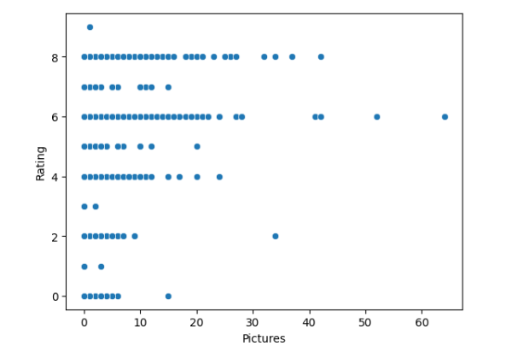
Chart - 2
CODE:
sns.scatterplot(x='Pictures', y='Rating', data=df)
plt.show()

Slide 25
1. Why did you pick the specific chart?
A scatter plot is best for showing the relationship between two numerical variables. This helps analyze whether pictures influence ratings.

Slide 26
2. What is/are the insight(s) found from the chart?
Reviews with more pictures often have higher ratings.
Customers who upload images are more engaged.
Low-picture reviews show more rating variation.

Slide 27
3. Will the gained insights help creating a positive business impact?
Are there any insights that lead to negative growth? Justify with specific reason.
Encouraging photo uploads can increase trust and ratings.

Slide 28
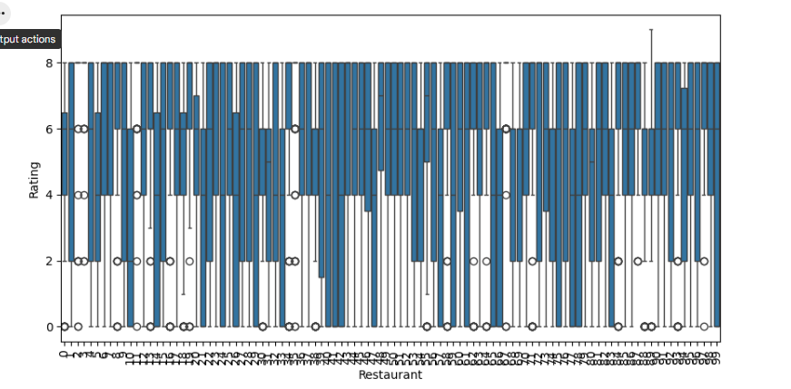
Chart - 3
CODE:
plt.figure(figsize=(10,5))
sns.boxplot(x='Restaurant', y='Rating', data=df)
plt.xticks(rotation=90)
plt.show()

Slide 29
1. Why did you pick the specific chart?
Boxplots compare rating distributions across restaurants.

Slide 30
2. What is/are the insight(s) found from the chart?
Some restaurants consistently get higher ratings.
Some restaurants have large rating variation.

Slide 31
3. Will the gained insights help creating a positive business impact?
Are there any insights that lead to negative growth? Justify with specific reason.
Helps identify top-performing restaurants.

Slide 32
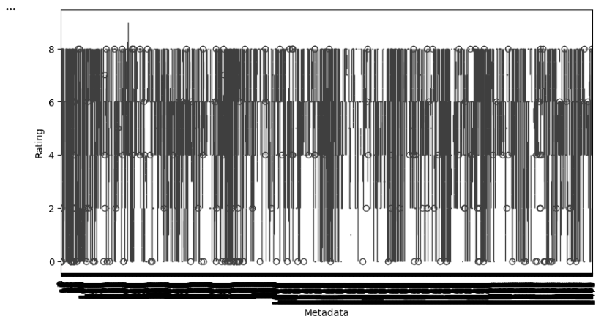
Chart - 4
CODE:
plt.figure(figsize=(10,5))
sns.boxplot(x='Metadata', y='Rating', data=df)
plt.xticks(rotation=90)
plt.show()

Slide 33
1. Why did you pick the specific chart?
Shows how contextual data affects ratings.

Slide 34
2. What is/are the insight(s) found from the chart?
Certain metadata categories have higher ratings.
Some categories receive mixed feedback.

Slide 35
3. Will the gained insights help creating a positive business impact?
Are there any insights that lead to negative growth? Justify with specific reason.
Helps understand customer preferences.

Slide 36
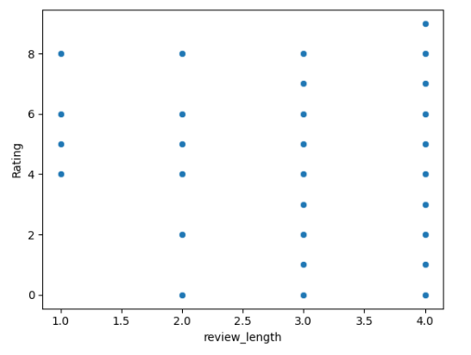
Chart - 5
CODE:
df['review_length'] = df['Review'].astype(str).apply(len)
sns.scatterplot(x='review_length', y='Rating', data=df)
plt.show()

Slide 37
1. Why did you pick the specific chart?
To see if longer reviews reflect stronger opinions.

Slide 38
2. What is/are the insight(s) found from the chart?
Longer reviews often indicate strong experiences.
Extreme ratings (very good/bad) have longer reviews.

Slide 39
3. Will the gained insights help creating a positive business impact?
Are there any insights that lead to negative growth? Justify with specific reason.
Text feedback gives valuable insights.

Slide 40
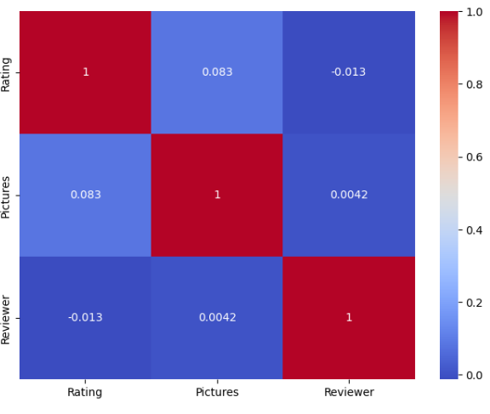
Chart - 6
CODE:
plt.figure(figsize=(8,6))
sns.heatmap(df[['Rating','Pictures','Reviewer']].corr(), annot=True, cmap='coolwarm')
plt.show()

Slide 41
1. Why did you pick the specific chart?
Shows relationships between numeric features.

Slide 42
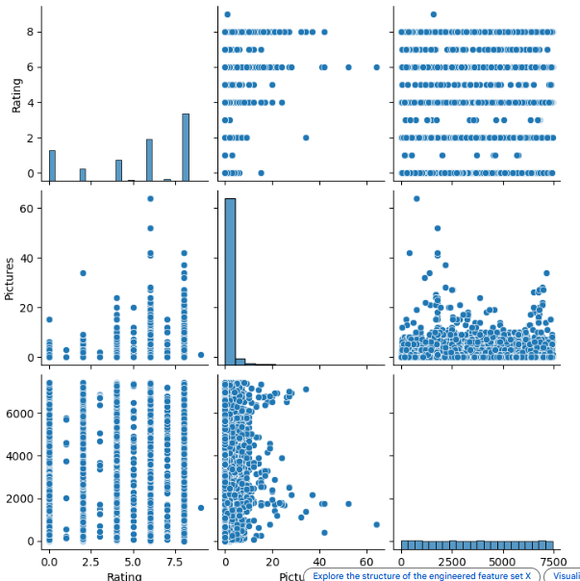
Chart – 7
sns.pairplot(df[['Rating','Pictures','Reviewer']])
plt.show()

Slide 43
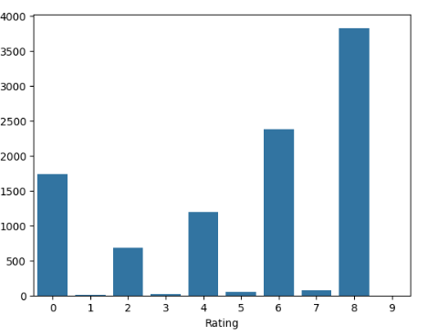
Chart – 8
sns.countplot(x='Rating', data=df)
plt.show()

Slide 44
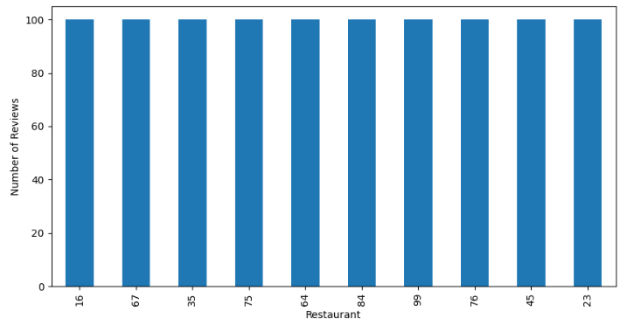
Chart – 9
plt.figure(figsize=(10,5))
df['Restaurant'].value_counts().head(10).plot(kind='bar')
plt.xlabel("Restaurant")
plt.ylabel("Number of Reviews")
plt.show()

Slide 45
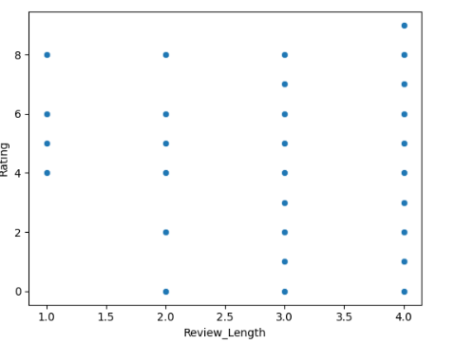
Chart – 10
df['Review_Length'] = df['Review'].astype(str).apply(len)
sns.scatterplot(x='Review_Length', y='Rating', data=df)
plt.show()

